Slide 1



SMART INDIA HACKATHON 2025
Problem Statement ID : SIH25053
Problem Statement Title : Improved Onion storage technology for enhancing shelf life of onions
Theme : Agriculture, FoodTech & Rural Development
PS Category : Hardware
Team ID : 88746
Team Name : BRAINWASE

Slide 2

IDEA TITLE : Improved Onion storage technology for
enhancing shelf life of onions
Problem Statement
A large share of onions is lost post-harvest due to inadequate storage and uncontrolled temperature.
Losses lead to sprouting , rotting and reduced shelf life causing market price fluctuations.
Proposed Solution
Smart IoT storage with sensors, automation & dashboard.
Reduces spoilage, extends shelf life & helps farmers.
Low-cost, solar powered, with ethylene detection & scalability.
@SIH Idea submission- Template

Slide 3
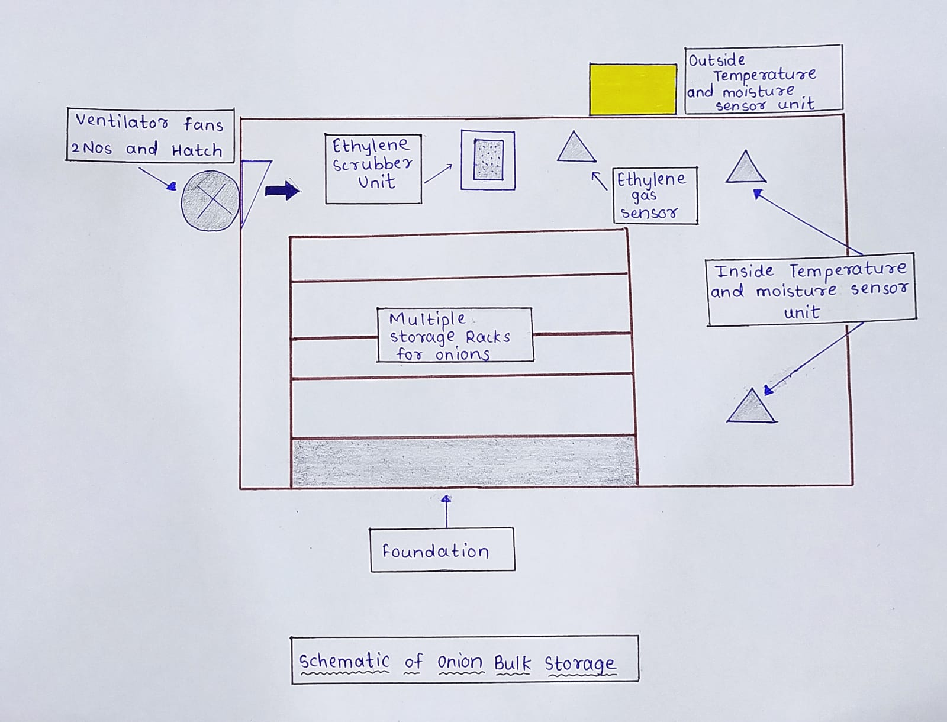
TECHNICAL APPROACH
Technologies to be Used
Methodology & Process
Hardware
Software
ESP-32
C++ (Arduino IDE)
DHT22
Python
Figaro
React/Flutter (dashboard)
Exhaust fans
Solar + electricity
@SIH Idea submission- Template

Slide 4
FEASIBILITY AND VIABILITY
Feasibility:
Radiation-based cold storage: Extends shelf life up to 7–8 months.
Dehydration: Preserves onions up to 12 months.
Controlled Atmosphere Storage (CAS): Delays spoilage and microbial growth.
Ethylene Scrubber Units: Removes excess ethylene, preventing sprouting and reducing post-harvest losses.
Viability:
Reduces post-harvest losses.
Extends shelf life, improving market timing
@SIH Idea submission- Template

Slide 5
IMPACT AND BENEFITS
IMPACTS :
1.INCREASED FARMER PROFIT - Reduction in post-harvest onion losses.
2.STABLE SUPPLY AND PRICE CONTROL - Extended storage enables onions to be available even during off-seasons and stabilization of onion prices in the market.
3.SUPPORT FOR EXPORT QUALITY - Improved onion quality during storage and distribution.
4.SOCIAL IMPACT - Boost to rural economy through agri-tech adoption.Benefits of the solution (social, economic, environmental,etc.)
BENIFITS :
1.FARMER'S INCOME SECURITY - Farmers can earn more profit by storing and selling onions at better prices.
2.AFFORDABLITY - Consumers also get onions at affordable prices year-round.
3.IMPROVED QUALITY AND HYGIENE - Longer shelf life can be there for continuous supply of onions in all seasons.
4.SUSTAINABLE TECHNOLOGY ADOPTION - Energy-efficient and sustainable storage solutions by solar/IoT.
@SIH Idea submission- Template

Slide 6
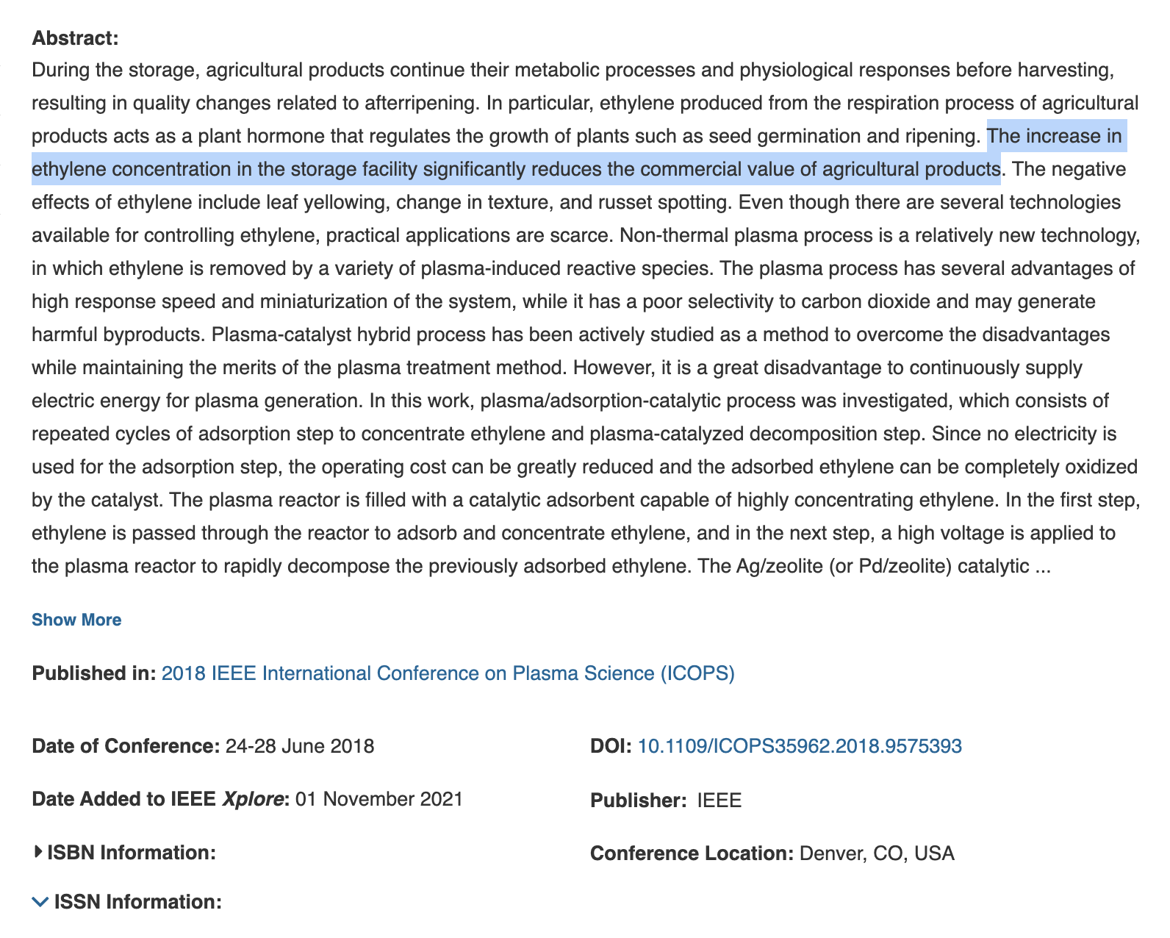
RESEARCH AND REFERENCES
RESEARCH:
REFERENCES:
https://ieeexplore.ieee.org/document/9575393
Published in: 2018 IEEE International Conference on Plasma Science (ICOPS)
Date of Conference: 24-28 June 2018
Date Added to IEEE Xplore: 01 November 2021
ISBN Information:
ISSN Information:
DOI: 10.1109/ICOPS35962.2018.9575393
Conference Location: Denver, CO, USA
Suslow, T.V., 2000. Post-harvest handling for organic crops. Organic Vegetable Production in California Series. Pub. 7254. University of California Davis. Available online at: https://anrcatalog.ucanr.edu/pdf/7254.pdf (verified 24 Dec 2019). Editor's note: this was written in 2000 and some of the information is no longer accurate. Check with your certifier before using any product on your organic farm.
@SIH Idea submission- Template

